Slide 1
Car driver drowsiness detection
Federico Cavedoni
Francesco Bruno

Slide 2
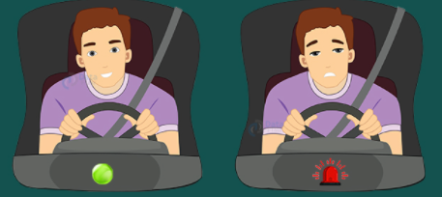
Drowsiness detection system
A system capable of understanding if the
driver is falling asleep by analysing his hearthbeat

Slide 3
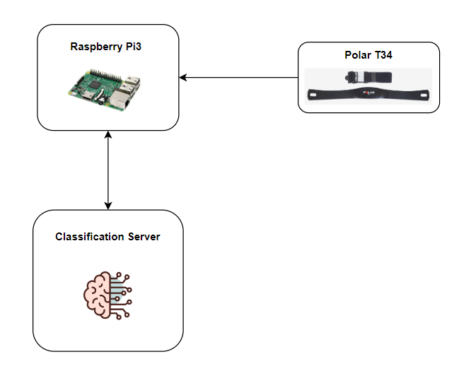
System description
The system is composed of:
ECG Sensor (Polar T34)
Sensor Controller (Raspberry PI 3)
Classification Server

Slide 4
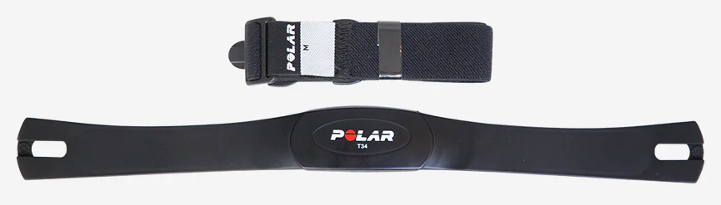
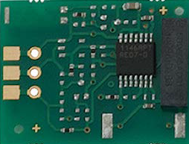
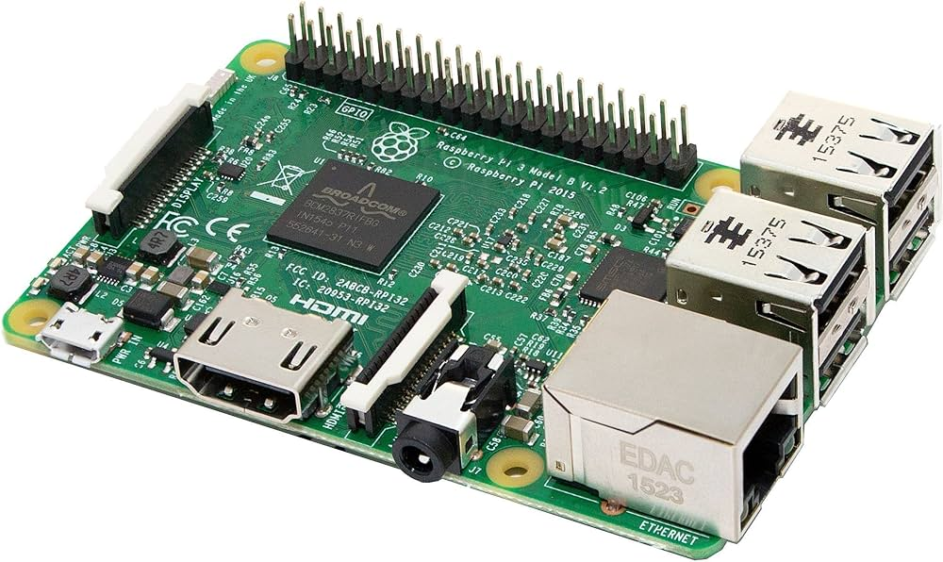
prototype description (1/2)
Hardware description
Polar T34
Polar Heart Rate Receiver
Raspberry PI 3

Slide 5

prototype description (2/2)
Controller Software
Classifier Server Software
• Communication_API.py
• Controller_firmware.py
• Hearth_beat_analysis.py
• Sensor_driver.py
• Communication_API.py
• Project_network.py
• Thread_receiver.py

Slide 6
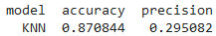

Performance evaluation (1/3)
KNeighborsClassifier
KNeighborsClassifier is used because it has great accuracy and good precision, respect to other types of classifiers
Scheduling
Scheduling is managed by the Raspbian O.S.

Slide 7


Performance evaluation (2/3)
Our SamplingTask is: (Soft – Firm – Hard) Real Time?
Firm-Task, because with deadline miss, it will lose the data becoming useless for the system. This event has been handled invalidating the session, restarting the sampling session (60s).
Periodic ?
Aperiodic ?
Sporadic ?
Minumum Interrival Time ~ 272mS
220BPM

Slide 8
Performance evaluation (3/3)
Deadline Analysis
Minimum Interarrival Time: ~272mS
WCET taskISR: 20uS
WCET MainThread: 100uS

Slide 9
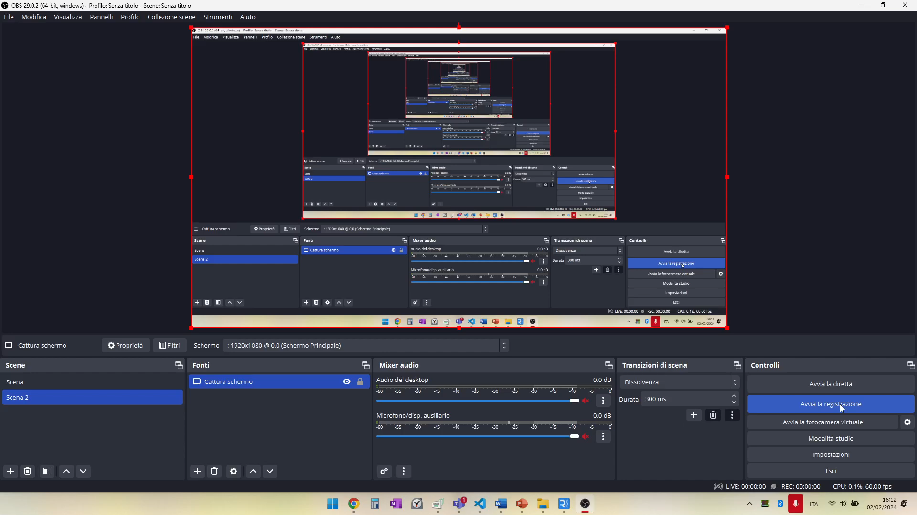
Demo (1/3): Normal situation

Slide 10
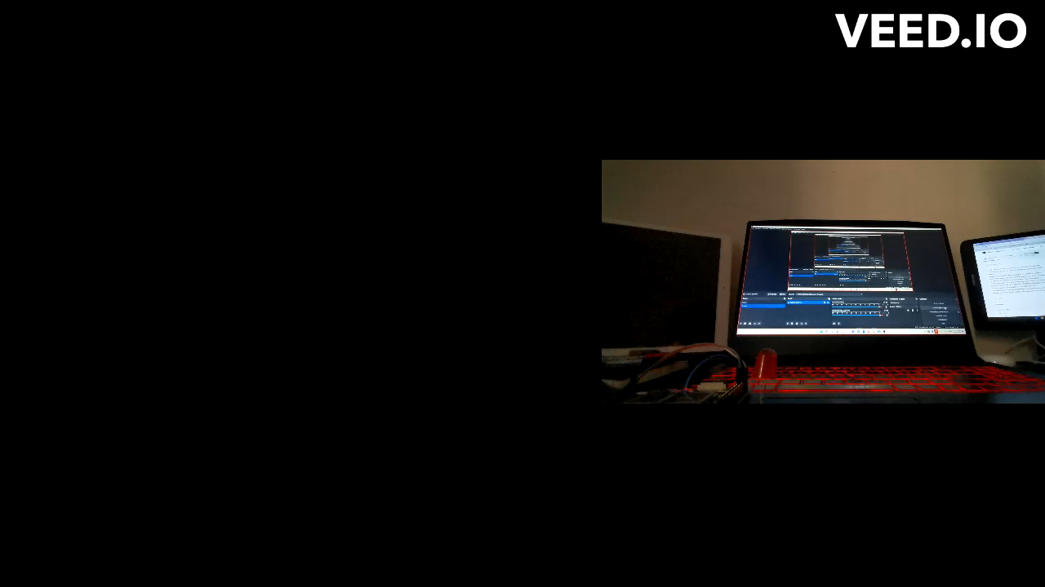
Demo (2/3): Abnormal classification

Slide 11
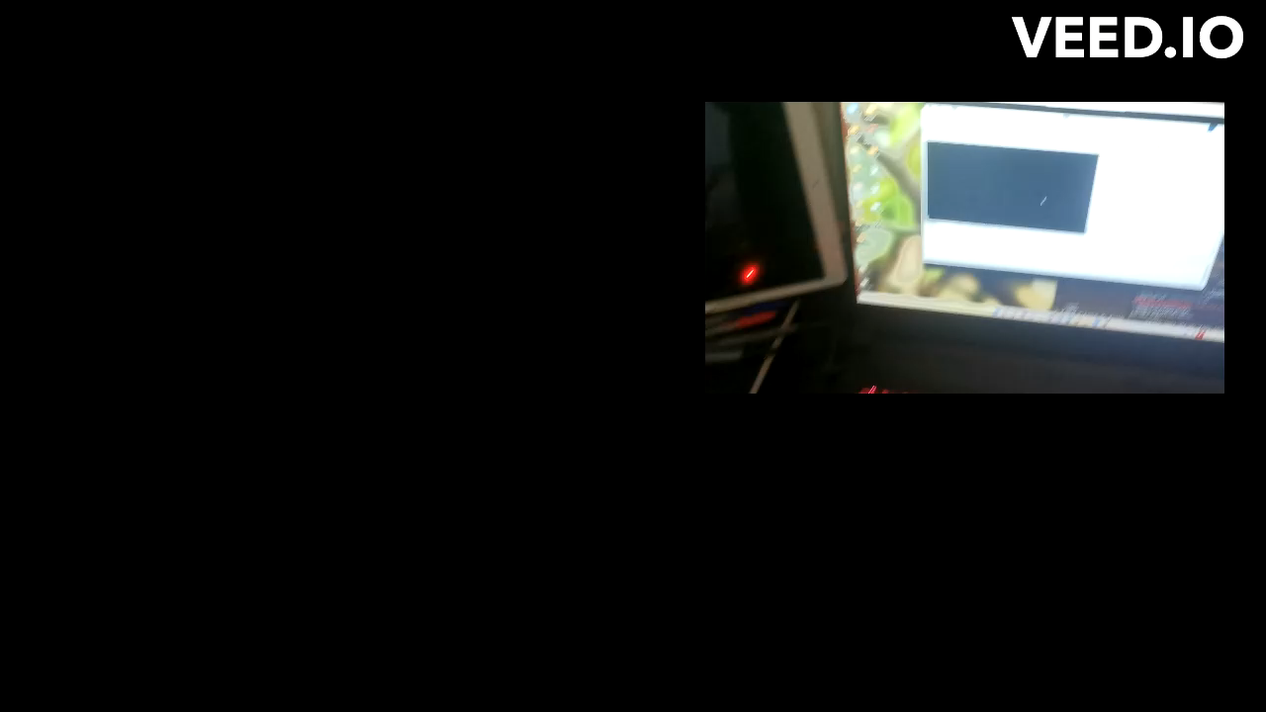
Demo (3/3): hands off steering wheel

Slide 12
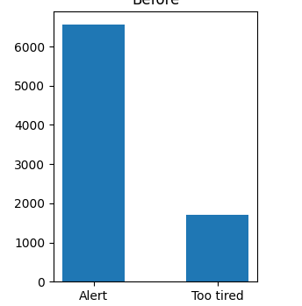
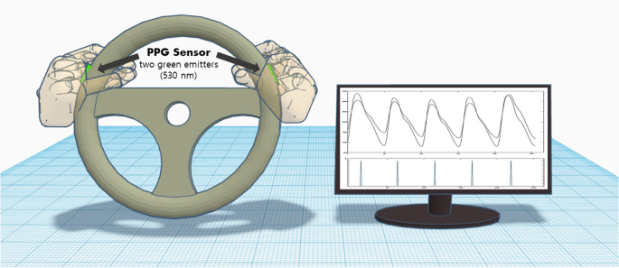
conclusions
Improve the training procedure
The classification is surely influenced by the unbalanced dataset used
Use a PPG sensor
For better classification due to the incrementing of the sensor precision and usability

Slide 13
references
PPG Cognitive Fatigue Prediction Source: https://www.kaggle.com/code/katariinaparkja/ppg-cognitive-fatigue-prediction

Slide 14
Thanks for the attention
Federico Cavedoni
Francesco Bruno

